Slide 1

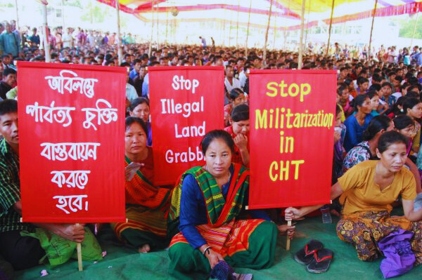

PRESENTED BY GROUP NO. 3
BALANCING SECURITY AND HUMAN RIGHTS IN CHITTAGONG HILL TRACK : VIOLATING IEEE CODE OF ETHICS NO : II
COURSE: ENGINEERING ETHICS​
Section: G
Course Faculty: DR. SHUVRA MONDAL

Slide 2
GROUP MEMBERS
MAHIYA AKTHER
ABDULLAH KHONDOKER
MOST. SAYMA KHATUN
M SHAHRIAR ALAM SHAJID
MD. SHOHANUR RAHMAN SHOHAN
ID 22-47359-2
CSE
ID 22-46373-1
CSE
22-47035-1
CSE
22-46242-1
CSE
22-46013-1
CSE

Slide 3
TABLE OF CONTENTS​
01
02
INTRODUCTION TO HISTORY AND THE RELEVANT CASE STUDY
IEEE CODE OF ETHICS No 2 AND ITS VIOLATION​
03
04
ETHICAL DILEMMA
FOUR STEPS FOR RESOLVING ETHICAL DILEMMA AND CONCLUSION

Slide 4
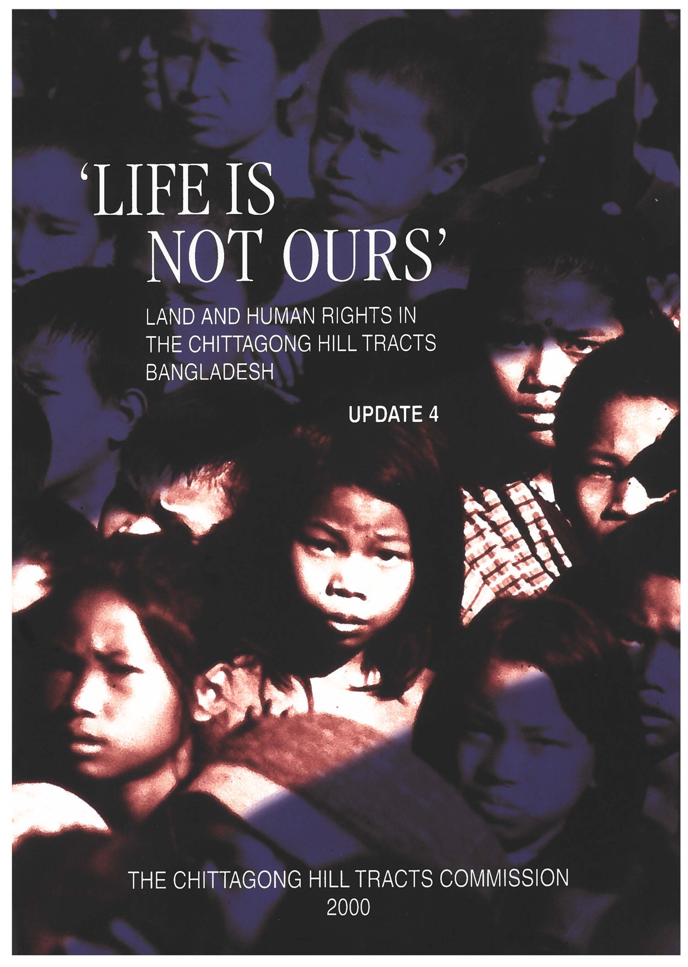
WHO ARE THE MINORITIES IN THE CHITTAGONG HILL TRACTS (CHT)?
Indigenous Peoples of CHT
Chittagong Hill Tracts (CHT) is home to a diverse mix of ethnic communities, with indigenous peoples forming a significant minority.
Key Indigenous Groups:
Chakma
Marma
Tripura
Mro
Bawm
Other Indigenous Groups:Kuki, Tanchangya, and Pankho are other smaller indigenous groups in CHT.
These groups have their own languages, customs, and beliefs, often animistic or influenced by Christianity.

Slide 5
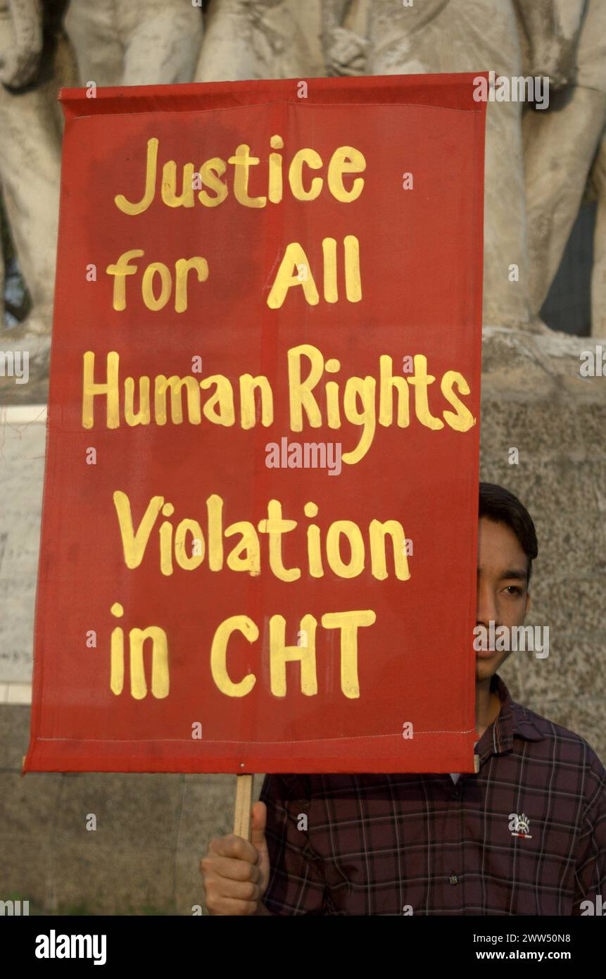

DIVERSITY AND CHALLENGES FACED BY THE MINORITY
Cultural and Linguistic Diversity
Languages.
Religions
Way of Life
Challenges Faced by Minorities:
Land Rights: Indigenous groups face displacement due to military and government activities.
Cultural Erosion
Political Marginalization:

Slide 6


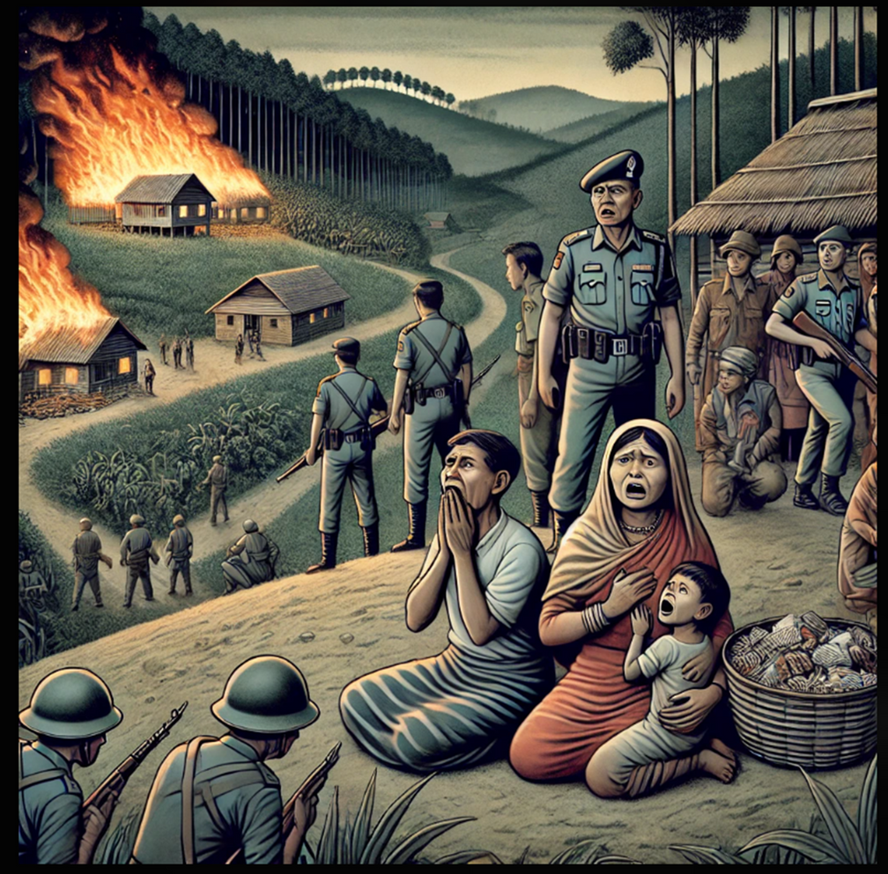
Case Study : Oppression of Indigenous Communities in Chittagong Hill Track
Suppose Dave is a human rights advocate assigned to improve communication and monitoring systems in the CHT. In September 2024, the Dighinala region in the Chittagong Hill Tracts (CHT) experienced a tragic escalation of ethnic violence. Reports indicate that settlers from the dominant Bengali community launched coordinated attacks against the Indigenous Jumma people. These attacks resulted in the deaths of four Indigenous men, the burning of at least 110 homes and businesses, and the forced displacement of numerous Indigenous families into surrounding forests.
The violence was allegedly triggered by false accusations against Indigenous individuals, compounded by disinformation spread through social media portraying the Indigenous population as "anti-state" or "separatists."

Slide 7

Case Study : Oppression of Indigenous Communities in Chittagong Hill Track
During the attacks, local law enforcement and military forces reportedly failed to intervene effectively, and in some cases, were accused of siding with the settlers. For instance, testimonies claimed that military personnel confiscated and deleted video evidence of the violence from the phones of Indigenous individuals, further undermining justice. Now Dave as a human rights advocate is approached by both Indigenous Jumma leaders and Bengali settler representatives. The Indigenous community requests you to document the violence they have faced, emphasizing the complicity of local authorities and the military. On the other hand, Bengali settlers claim they also face violence and marginalization.
Question : How should Dave navigate conflicting claims of violence respecting all communities regardless of race, caste, or origin?

Slide 8


IEEE Code of Ethics No 2
to treat all persons fairly and with respect, and to not engage in discrimination based on characteristics such as race, religion, gender, disability, age, national origin, sexual orientation, gender identity, or gender expression;
to not engage in harassment of any kind, including sexual harassment or bullying behavior;
to avoid injuring others, their property, reputation, or employment by false or malicious actions, rumors, or any other verbal or physical abuses;

Slide 9





Ethical Code Violation
Rule 7
Rule 8
Rule 9
Fairness and Respect
The Jumma people were unfairly attacked because of their ethnicity.
They were falsely labeled as "anti-state" or "separatists.“
Harassment
The Jumma people were attacked and had their homes burned.
False rumors were spread to encourage violence against them.
Avoiding Harm
False accusations caused physical harm and death.
Rumors damaged the Jumma people's reputation and safety.

Slide 10
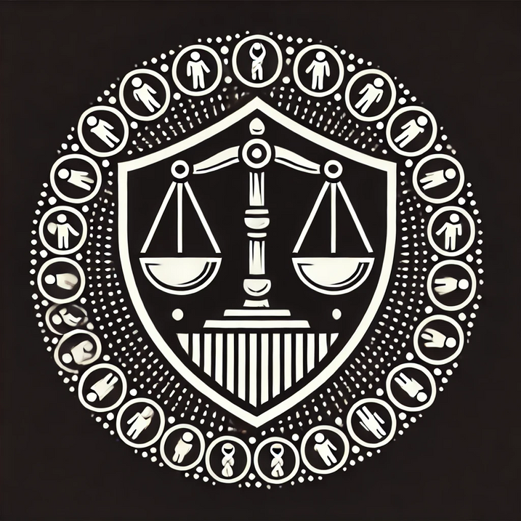
Purpose
Promote Fairness and Equality
Prevent Harassment and Bullying
Protect Reputation and Well-being

Slide 11
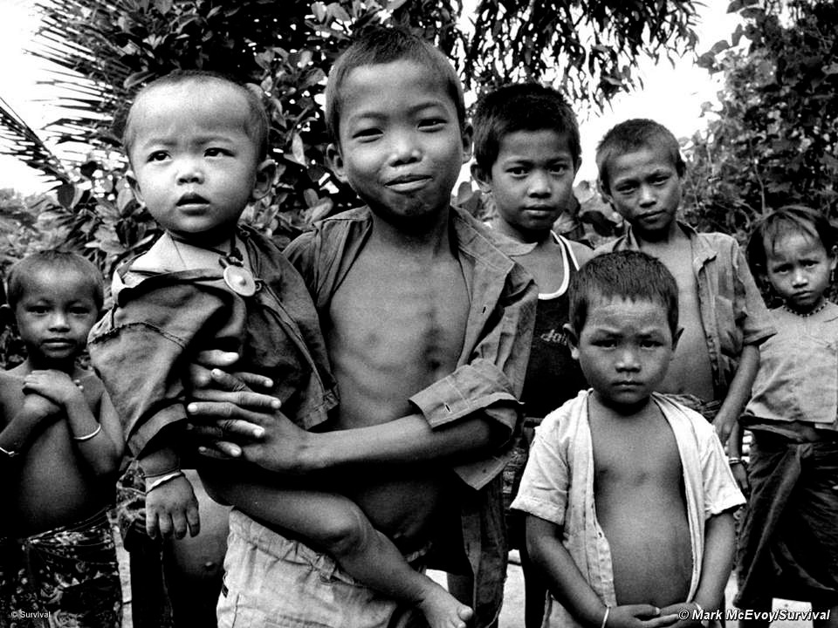
Introduction to the Ethical Dilemma
Dilemma:
Indigenous leaders seek justice by emphasizing their suffering and systemic bias.
Bengali settlers claim their side of the story must be documented to highlight their struggles.
Core question:
How can a human rights advocate remain impartial while addressing systemic injustice and ensuring fairness to all sides?

Slide 12
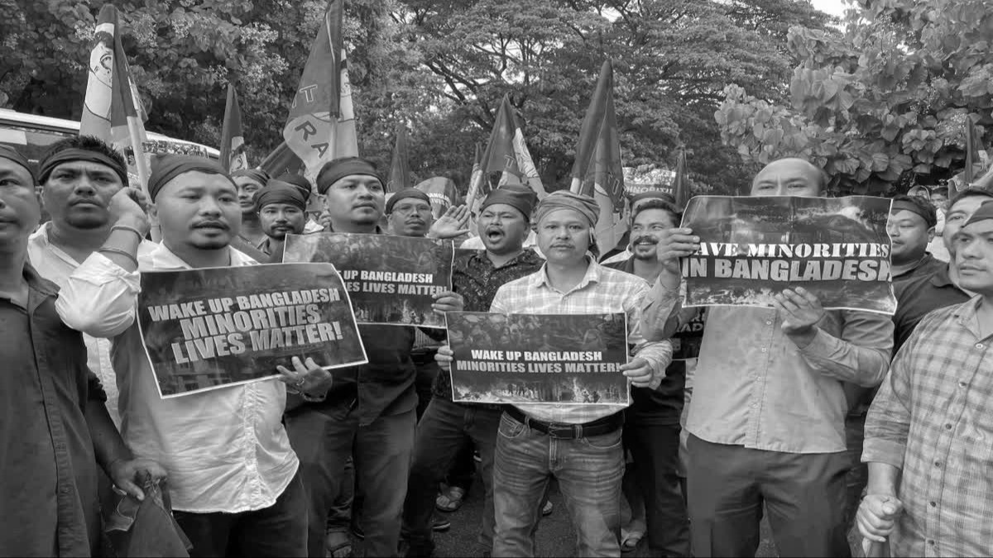

Exploring the Dilemma
Critical Conflicts
Impartiality versus justice
Balancing short-term risks against long-term solutions

Slide 13

Four Steps for Resolving Ethical Dilemma
01
02
Moral Clarity
Know the Facts
03
04
Make a Reasonable Decision
Consider Options

Slide 14

Four Steps for Resolving Ethical Dilemma
Step 1: Moral Clarity
Core Issue: Ensuring justice and safety for Indigenous Jumma people and Bengali settlers without discrimination.
Conflicting values: Protecting human rights, impartiality, and avoiding harm.

Slide 15
Four Steps for Resolving Ethical Dilemma
Step 2: Know the Facts
Key facts:
Four Indigenous people killed, 110 homes burned, families displaced.
Social media disinformation exacerbated violence.
Allegations of bias against law enforcement and military forces.
Stakeholders:
Indigenous Jumma, Bengali settlers, authorities, and society.

Slide 16
Four Steps for Resolving Ethical Dilemma
Step 3: Consider Options
Option 1: Deploy neutral forces for immediate safety.
Option 2: Independent investigation to ensure accountability.
Option 3: Monitor social media to counter disinformation.
Option 4: Initiate community dialogue for reconciliation.

Slide 17
Four Steps for Resolving Ethical Dilemma
Step 4: Make a Reasonable Decision
Combine Options 1, 2, and 3:
Deploy neutral forces for protection.
Conduct an independent investigation for justice.
Counter disinformation to prevent escalation.
REASON FOR TAKING THIS DECISIONS:
IEEE CODE OF ETHICS NO. TWO:
“To treat all persons fairly and with respect, to avoid harassment or discrimination, and to avoid injuring others.”

Slide 18

Conclusion
The combine decision aligns with IEEE principles by ensuring fairness, avoiding discrimination, and preventing harm. It provides impartial protection, immediate safety, and equitable accountability, fostering justice and rebuilding trust in institutions.

Slide 19

THANK YOU VERY MUCH!

